Slide 1



























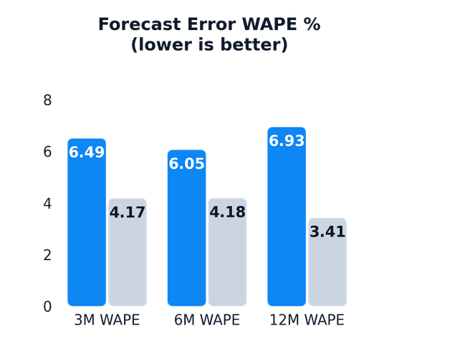
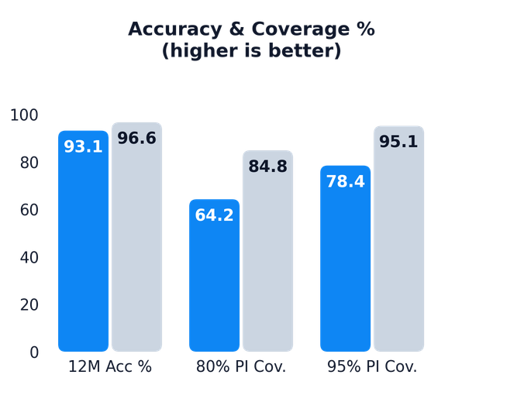
FEASIBILITY AND VIABILITY
Legacy Coderz
FEASIBILITY & SCALABILITY
Potential Challenges & Risks
Before: Traditional Manual Postal Process
After: AICTE Central Treasury Portal (SIH26265)
    Technically Viable : 100% operational Next.js 14 terminal; 45 automated unit tests pass (100% suite green); deterministic 8-rule discrepancy engine and SHA-256 Merkle-style audit ledger.
    Bank CBS API Heterogeneity — Varied CBS tech stacks across public, private, and co-operative banks.
    OCR Scan Degeneration — Low-resolution phone scans, folded certificates, and skewed orientations.
    Operationally Practical : Lightweight container deployable on NIC MeghRaj cloud (~4 vCPU, 16GB RAM); bilingual Hindi–English UI, 10-year renewal wizard, human-in-the-loop OCR review.
    False Positives on Mergers — Bank mergers (e.g. Syndicate into Canara) causing legacy IFSC codes.
VERIFIED REGULATORY PERFORMANCE GAINS
    Data Privacy Under DPDP Act — Exposing unmasked bank account & CIF numbers to statutory auditors.
    Economically Scalable : 100% open-source software stack (TypeScript, Next.js, Tailwind, SQLite/Prisma); zero licensing fees; scales from regional pilot to all 10,000+ colleges pan-India.
Verification: 45d → 1.5d (96.6% cut) | Discrepancy Intercept: 35% → 100% | Premature Leakage: Zero (3 Blocked)
Validated on 140-FDR synthetic regulatory benchmark • 60 institutions • 8 AICTE regions • 100% deterministic rules
    Officer Change Resistance — Skepticism toward automated priority queues and unfamiliarity with UI.
Strategies to Overcome Challenges
Key Insight (from Graph)
Regulatory Validation ( 8 Rules • 100-pt Score • SHA-256 )
    Standard SFMS MT760/767 Protocols — Direct bank-to-treasury advice with fallback to certified manual verification.
CRITICAL RISK
    Fatal Forgery Dossiers
    Conflicting Bank & IFSC Codes
    Immediate Scrutiny Halt (100-pt Flag)
    Laser Sweep Bounding Boxes — Real-time coordinate overlays with per-field confidence meters & human confirmation.
96.6% Turnaround Reduction — Automated CBS queries & SFMS MT760 protocols cut bank verification from 45 days of postal delay to 1.5 days.
Instant OCR Laser Scanner (<250 ms) — Next.js 14 + OCR engine runs on lightweight CPU/edge container; extracts coordinates with per-field confidence meters.
PENDING COMPLIANCE
    Canonical IFSC Mapping — Canonical mapping supports legacy branch codes with audited officer override notes.
KEY INSIGHTS
    EVC Deficit & Short Tenures
    Mandated 120-Mo Lock-in Lapsed
    Attention Queue Triage (Remediation)
STATUTORY COMPLIANT
    Role-Based Automated Masking — Server-side RBAC masks sensitive account strings for AUDITOR inspection role.
100% Discrepancy Intercept — 8-rule deterministic engine catches IFSC mismatches, temporal date inversions, and duplicate pledges across colleges.
100% Cryptographic Audit Trail — SHA-256 append-only chained ledger gives Regulation Bureau & statutory auditors tamper-evident proof.
    Approved 3-Yr EoA Deposits
    Joint RO Lien Confirmed in CBS
    Release-Ready Queue (Zero Deficit)
    100% Explainable Attention Score — Transparent formula modal and interactive guided scenario player in header.
@SIH Idea submission- Template
4

